Slide 1



Class 9: Machine Learning - Random Forest
UNIT III: Advanced Analytics and Machine Learning Models
Sebastián Muñoz-Herrera, PhD.
Héctor Hormazábal
Muñoz-Herrera and Hormazábal Class 9: Machine Learning – Random Forest UNIT III: Advanced Analytics and Machine Learning Models

Slide 2
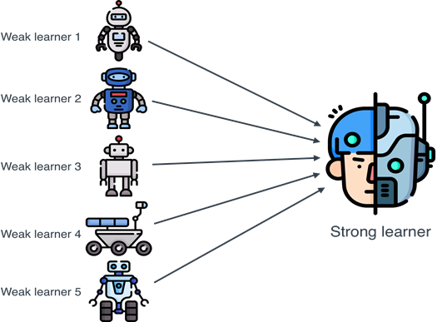
Why ensembled methods?
Combine multiple models (base learners) to improve performance
Goal: Reduce variance, bias, or both compared to single models
Key idea: Weak learners → strong committee
Analogy: "Wisdom of the crowd"
Muñoz-Herrera and Hormazábal Class 9: Machine Learning – Decision Tree UNIT III: Advanced Analytics and Machine Learning Models
Notes:
Let me walk you through the four units of the course so you know exactly where we're headed.
Unit I, which starts today, covers the Fundamentals of Business Intelligence — what it is, how it works, where data comes from.
Unit II moves into Data Preparation and Predictive Models — this is where you'll get your hands dirty cleaning and modeling data.
Unit III is the exciting one: Advanced Analytics and Machine Learning.
And Unit IV brings it all together with a focus on communicating insights ethically to support decision-making.
Notice how the course is structured like a pipeline: first you understand BI, then you prepare data, then you build models, and finally you communicate results. Each unit builds on the previous one — so keeping up with the pace really matters.
If at any point you feel lost, reach out early. We'd rather help you now than rescue you at the final exam.

Slide 3
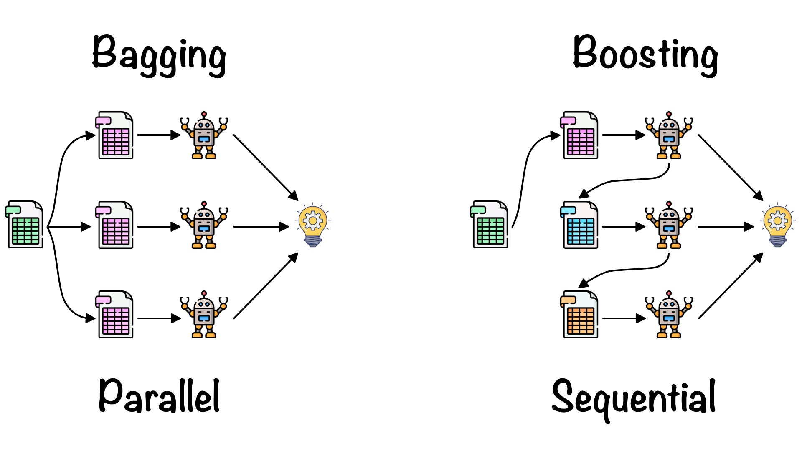
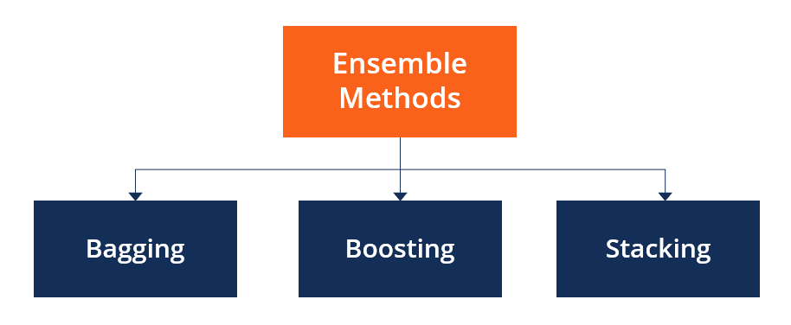
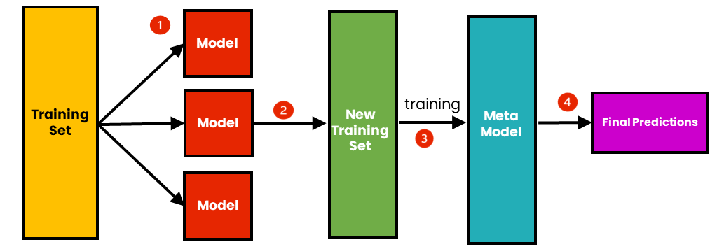
Three Main Ensemble Families
Train models in parallel on bootstrapped data
Reduce variance
Train a meta-model on base model outputs
Combine strengths
Train models sequentially
correct errors. Reduce bias
Muñoz-Herrera and Hormazábal Class 9: Machine Learning – Decision Tree UNIT III: Advanced Analytics and Machine Learning Models
Notes:
Let me walk you through the four units of the course so you know exactly where we're headed.
Unit I, which starts today, covers the Fundamentals of Business Intelligence — what it is, how it works, where data comes from.
Unit II moves into Data Preparation and Predictive Models — this is where you'll get your hands dirty cleaning and modeling data.
Unit III is the exciting one: Advanced Analytics and Machine Learning.
And Unit IV brings it all together with a focus on communicating insights ethically to support decision-making.
Notice how the course is structured like a pipeline: first you understand BI, then you prepare data, then you build models, and finally you communicate results. Each unit builds on the previous one — so keeping up with the pace really matters.
If at any point you feel lost, reach out early. We'd rather help you now than rescue you at the final exam.

Slide 4
Bagging
Create X bootstrapped datasets (sample with replacement.
Train a separate model on each dataset
Aggregate predictions:
Classification: majority vote
Regression: average
Effect: Lowers variance without increasing bias much
Muñoz-Herrera and Hormazábal Class 9: Machine Learning – Decision Tree UNIT III: Advanced Analytics and Machine Learning Models
Notes:
Let me walk you through the four units of the course so you know exactly where we're headed.
Unit I, which starts today, covers the Fundamentals of Business Intelligence — what it is, how it works, where data comes from.
Unit II moves into Data Preparation and Predictive Models — this is where you'll get your hands dirty cleaning and modeling data.
Unit III is the exciting one: Advanced Analytics and Machine Learning.
And Unit IV brings it all together with a focus on communicating insights ethically to support decision-making.
Notice how the course is structured like a pipeline: first you understand BI, then you prepare data, then you build models, and finally you communicate results. Each unit builds on the previous one — so keeping up with the pace really matters.
If at any point you feel lost, reach out early. We'd rather help you now than rescue you at the final exam.

Slide 5
Boosting
Train models sequentially
Each new model focuses on errors of previous models
Weighted combination of all models
Effect: Reduces bias, can also reduce variance (if tuned)
Muñoz-Herrera and Hormazábal Class 9: Machine Learning – Decision Tree UNIT III: Advanced Analytics and Machine Learning Models
Notes:
Let me walk you through the four units of the course so you know exactly where we're headed.
Unit I, which starts today, covers the Fundamentals of Business Intelligence — what it is, how it works, where data comes from.
Unit II moves into Data Preparation and Predictive Models — this is where you'll get your hands dirty cleaning and modeling data.
Unit III is the exciting one: Advanced Analytics and Machine Learning.
And Unit IV brings it all together with a focus on communicating insights ethically to support decision-making.
Notice how the course is structured like a pipeline: first you understand BI, then you prepare data, then you build models, and finally you communicate results. Each unit builds on the previous one — so keeping up with the pace really matters.
If at any point you feel lost, reach out early. We'd rather help you now than rescue you at the final exam.

Slide 6
Stacking
Train multiple base models (can be different algorithms)
Use predictions of base models as features
Train a meta-model to make final prediction
Effect: Captures diverse patterns; often gives best performance
Muñoz-Herrera and Hormazábal Class 9: Machine Learning – Decision Tree UNIT III: Advanced Analytics and Machine Learning Models
Notes:
Let me walk you through the four units of the course so you know exactly where we're headed.
Unit I, which starts today, covers the Fundamentals of Business Intelligence — what it is, how it works, where data comes from.
Unit II moves into Data Preparation and Predictive Models — this is where you'll get your hands dirty cleaning and modeling data.
Unit III is the exciting one: Advanced Analytics and Machine Learning.
And Unit IV brings it all together with a focus on communicating insights ethically to support decision-making.
Notice how the course is structured like a pipeline: first you understand BI, then you prepare data, then you build models, and finally you communicate results. Each unit builds on the previous one — so keeping up with the pace really matters.
If at any point you feel lost, reach out early. We'd rather help you now than rescue you at the final exam.

Slide 7

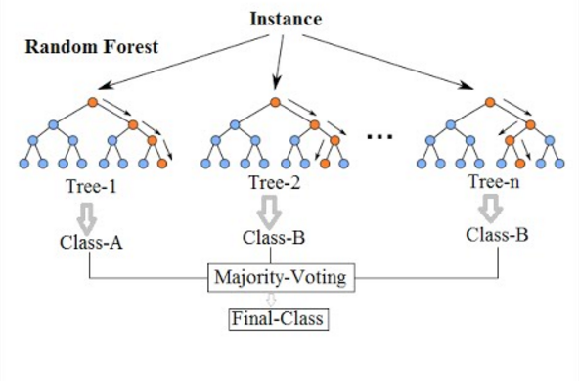
Random Forest
Extension of bagged decision tres
Adds extra randomness during tree building
Builds many deep, uncorrelated tres
Final prediction: average (regression) or majority vote (classification)
Key benefits: Robust, handles non-linearities, feature importance
Muñoz-Herrera and Hormazábal Class 9: Machine Learning – Decision Tree UNIT III: Advanced Analytics and Machine Learning Models
Notes:
Let me walk you through the four units of the course so you know exactly where we're headed.
Unit I, which starts today, covers the Fundamentals of Business Intelligence — what it is, how it works, where data comes from.
Unit II moves into Data Preparation and Predictive Models — this is where you'll get your hands dirty cleaning and modeling data.
Unit III is the exciting one: Advanced Analytics and Machine Learning.
And Unit IV brings it all together with a focus on communicating insights ethically to support decision-making.
Notice how the course is structured like a pipeline: first you understand BI, then you prepare data, then you build models, and finally you communicate results. Each unit builds on the previous one — so keeping up with the pace really matters.
If at any point you feel lost, reach out early. We'd rather help you now than rescue you at the final exam.

Slide 8
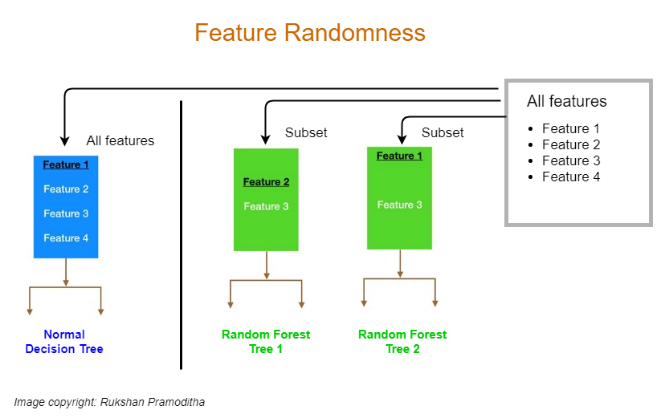
Random Forest
Why double randomness? → Decreases correlation among trees → lower variance
Randomness type | Description
Rows (bootstrap) | Each tree trained on a different bootstrap sample of the data
Features (subspace) | At each split, consider only a random subset of features (typically √p for classification, p/3 for regression)
Muñoz-Herrera and Hormazábal Class 9: Machine Learning – Decision Tree UNIT III: Advanced Analytics and Machine Learning Models
Notes:
Let me walk you through the four units of the course so you know exactly where we're headed.
Unit I, which starts today, covers the Fundamentals of Business Intelligence — what it is, how it works, where data comes from.
Unit II moves into Data Preparation and Predictive Models — this is where you'll get your hands dirty cleaning and modeling data.
Unit III is the exciting one: Advanced Analytics and Machine Learning.
And Unit IV brings it all together with a focus on communicating insights ethically to support decision-making.
Notice how the course is structured like a pipeline: first you understand BI, then you prepare data, then you build models, and finally you communicate results. Each unit builds on the previous one — so keeping up with the pace really matters.
If at any point you feel lost, reach out early. We'd rather help you now than rescue you at the final exam.

Slide 9
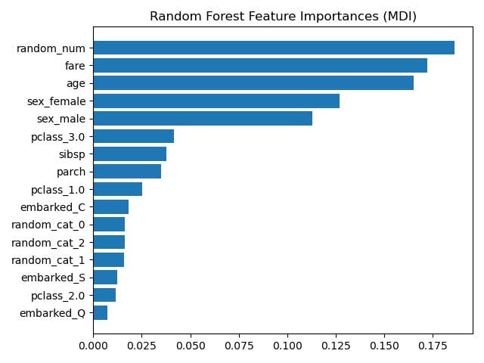
Feature Importance
Based on impurity reduction (Gini or entropy for classification, MSE for regression)
For each feature, average the total decrease in impurity across all splits (weighted by number of samples)
Limitations: biased toward high-cardinality or continuous features
Muñoz-Herrera and Hormazábal Class 9: Machine Learning – Decision Tree UNIT III: Advanced Analytics and Machine Learning Models
Notes:
Let me walk you through the four units of the course so you know exactly where we're headed.
Unit I, which starts today, covers the Fundamentals of Business Intelligence — what it is, how it works, where data comes from.
Unit II moves into Data Preparation and Predictive Models — this is where you'll get your hands dirty cleaning and modeling data.
Unit III is the exciting one: Advanced Analytics and Machine Learning.
And Unit IV brings it all together with a focus on communicating insights ethically to support decision-making.
Notice how the course is structured like a pipeline: first you understand BI, then you prepare data, then you build models, and finally you communicate results. Each unit builds on the previous one — so keeping up with the pace really matters.
If at any point you feel lost, reach out early. We'd rather help you now than rescue you at the final exam.

Slide 10
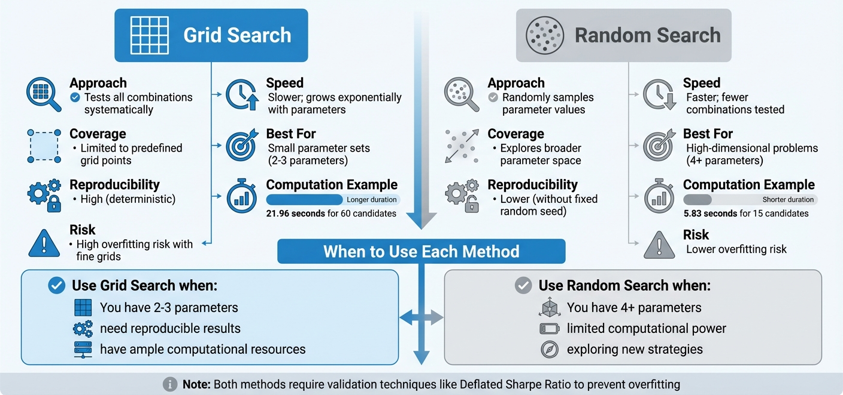
Hyperparameters Search
Muñoz-Herrera and Hormazábal Class 9: Machine Learning – Decision Tree UNIT III: Advanced Analytics and Machine Learning Models
Notes:
Let me walk you through the four units of the course so you know exactly where we're headed.
Unit I, which starts today, covers the Fundamentals of Business Intelligence — what it is, how it works, where data comes from.
Unit II moves into Data Preparation and Predictive Models — this is where you'll get your hands dirty cleaning and modeling data.
Unit III is the exciting one: Advanced Analytics and Machine Learning.
And Unit IV brings it all together with a focus on communicating insights ethically to support decision-making.
Notice how the course is structured like a pipeline: first you understand BI, then you prepare data, then you build models, and finally you communicate results. Each unit builds on the previous one — so keeping up with the pace really matters.
If at any point you feel lost, reach out early. We'd rather help you now than rescue you at the final exam.

